Slide 1
Amazon Forecast
Accurate time-series forecasting service, based on the same technology used at Amazon.com, no machine learning experience required
Péter Molnár, Feburary 2021

Slide 2





















The AWS ML Stack Broadest and most complete set of machine learning capabilities
AI SERVICES
HEALTHCARE AI
INDUSTRIAL AI
ANOMOLY DETECTION
CODE AND DEVOPS
NEW
Amazon HealthLake
Amazon Transcribe for Medical
Amazon Comprehend for Medical
NEW
AWS Panorama + Appliance
NEW
Amazon Monitron
NEW
Amazon Lookout for Equipment
NEW
Amazon Lookout for Vision
NEW
Amazon Lookout for Metrics
NEW
Amazon DevOps Guru
Amazon CodeGuru
 | VISION | SPEECH | TEXT | SEARCH | CHATBOTS | PERSONALIZATION | FORECASTING | FRAUD | CONTACT CENTERS
Amazon Rekognition
Amazon Polly
Amazon Transcribe
+Medical
Amazon Comprehend
+Medical
Amazon Translate
Amazon Textract
Amazon Kendra
Amazon Lex
Amazon Personalize
Amazon Forecast
Contact Lens
Amazon Fraud Detector
Voice ID
For Amazon Connect
ML SERVICES
SAGEMAKER STUDIO IDE
Label data | Aggregate & prepare data | Store & share features | Auto ML | Spark/R | Detect bias | Visualize in notebooks | Pick algorithm | Train models | Tune parameters | Debug & profile | Deploy in production | Manage & monitor | CI/CD | Human review
Ground Truth | NEW Data Wrangler | NEW Feature store | Autopilot | Processing | NEW Clarify | Studio Notebooks | Built-in or Bring-your-own | NEW Experiments Spot Training Distributed Training | Automatic Model Tuning | Debugger | NEW Model Hosting Multi-model Endpoints | Model Monitor | NEW Pipelines | Augmented AI
Amazon SageMaker
AMAZON SAGEMAKER JUMPSTART
NEW: AMAZON SAGEMAKER EDGE MANAGER
FRAMEWORKS & INFRASTRUCTURE
Deep Learning AMIs & Containers | GPUs & CPUs | Elastic Inference | Trainium | Inferentia | FPGA
DeepGraphLibrary
Notes:
We’re innovating on behalf of our customers to deliver the broadest and deepest set of machine learning capabilities for builders of all levels of expertise. At each layer of the stack, we’re investing in removing the undifferentiated heavy lifting so your teams can move faster.
At the top layer are our AI Services, which allow developers to easily add intelligence to any application without needing ML skills. The pre-trained models provide ready-made intelligence for your applications and workflows to help you do things like personalize the customer experience, forecast business metrics, translate conversations, extract meaning from documents and more. At the middle layer is Amazon SageMaker, which provides every developer and data scientist with the ability to build, train, and deploy machine learning models at scale. It removes the complexity from each step of the machine learning workflow so you can more easily deploy your machine learning use cases, anything from predictive maintenance to computer vision to predicting customer behaviors. Customer achieve up to 10 times improvement in data scientists’ productivity with Amazon SageMaker. And at the bottom layer, expert practitioners can develop on the framework of their choice as a managed experience in Amazon SageMaker or use the AWS Deep Learning AMIs (Amazon machine images), which are fully configured with the latest versions of the most popular deep learning frameworks and tools.

Slide 3
The current landscape of forecasting and customer expectations
The power of forecasting and business benefits
Agenda
Quickly generate highly accurate forecasts with Amazon Forecast
Customer Success Stories
Next steps
Notes:
Today, we’d like to talk about…[walk through agenda]

Slide 4






THE CURRENT LANDSCAPE
Customers increasingly want more variety, they want it immediately, and they want it cheaply
Accurate and flexible forecasts are key; however, traditional methods cannot capture the increasing number of demand signals and complexity
Market leaders are investing in ML-driven forecasting to more effectively meet demand
Harvard Business Review, McKinsey Global Institute
https://www.mckinsey.com/business-functions/mckinsey-analytics/our-insights/most-of-ais-business-uses-will-be-in-two-areas
20% accuracy improvements
5% inventory reduction
3% increase in revenue
Notes:
Forecasting touches your life on a daily basis, it is what ensures grocery shelves are stocked, packages are delivered on time, and wait times for your favorite restaurant or delivery are short.
Customers increasingly demand individualized goods and services, they want them immediately, and they want them cheaply. Providing variety and instant service requires more elaborate supply chains, but to do so efficiently requires accurate and agile demand forecasting.
While all business use some form of forecasting today, traditional methods cannot make use of the increasing number of demand signals available today to forecasting an ever more complex landscape. In fact, on third of the total value created from artificial intelligence applications is expected to come from more accurate forecasting
Market leaders are making investments to bring in flexible, accurate ML-forecasting to all parts of their business. According to a recent study McKinsey, organizations that have implemented ML forecasting techniques improved forecasting accuracy by 10 to 20 percent, which translated into a 5% reduction in inventory costs and 2-3% increase in revenue.

Slide 5
FORECASTING OVERVIEW
The science of prediction based on historical trends
HISTORICAL TRENDS
FORECAST HORIZON
B
Forecasting seeks to minimize:
Under-forecast errors that results in missed opportunity
Over-forecast errors that result in wasted resources
A
A
B
Notes:
Forecasting is the science of predicting the future. By examining historical trends, organizations can make a call on what might happen and when, and build that into their future plans for everything from product demand to inventory to staffing.
Given the consequences of forecasting, accuracy really matters.
If the forecast is too low, they will under-invest, which leads to a shortfall in raw materials and inventory; creating a poor customer experience.
If a forecast is too high, customers will over-invest in products and staff, which ends up as wasted investment.
Today, companies try to use everything from simple spreadsheets to complex financial planning software to generate forecasts, but high accuracy remains elusive.

Slide 6


IMPROVING BUSINESS OUTCOMES The power of forecasting
INVENTORY PLANNING
WORKFORCE PLANNING
Improve demand planning at granular levels
Reduce waste, increase inventory turns, and improve in-stock availability
More effectively staff to meet varying demand levels
Improve utilization, time to serve, and customer satisfaction
CAPACITY PLANNING
FINANCIAL PLANNING
Make longer term decisions with more confidence
Improve capital utilization
Plan for sales and top-line revenue
Effectively manage cash flows
Notes:
Accurate demand forecasting is applicable across a variety of industries and functions
Within retail and supply chains, it allows customers to meet demand while holding less inventory
Within customer support or service industries, it enables customers to reduce wait times and improve satisfaction
When applied to capital intensive processes, it allows customers to improve utilization and efficiently allocate scarce resources
When applied to business functions, it allows customers to plan further ahead and spend less time reacting to surprises

Slide 7








BASED ON THE TECHNOLOGY THAT POWERS AMAZON.COM The evolution of forecasting over 20+ years
STATISTICAL METHODS
ML METHODS
ML + DEEP LEARNING
1995
2000
2005
2010
2015
2020
Best for few or independent data (e.g., aggregate demand)
Aggregate demand
Everyday household products
Basic trends
Repeated seasonal patterns
Best for complex and inter-related data (e.g., thousands of SKUs at hundreds of stores)
Regional vs national demand
Subtle seasonal patterns
Relationships between products
New products
Slow moving products
Changing prices or promotions
External events
© 2020 Amazon Web Services, Inc. or its affiliates. All rights reserved |
7
Notes:
From the beginning, Amazon has invested in forecasting. Our investments of followed 3 phases.
First, we began with traditional statistical which work very well for basic data sets and capturing simple trends and patterns; however, we ran into limitation as our supply chains became more complex and product assortment became more varied.
Second, in the mid 2000’s we began investing in ML technologies to operationalize forecasting at much larger scales. This approach allowed us to manage scenarios where customers demand patterns varied by region and product.
Third, around 2015, we began investing deep learning approaches to tackle some of the hardest problems such as forecasting demand for new product introduction and the impact of external events. These new models are global in nature meaning they not only learn from historical data, but also learn subtle relationships across products that lead to a step change in forecasting accuracy at scale.

Slide 8

Highly accurate Train and deploy ML models which can be up to 50% more accurate than traditional methods. No deep learning experience required
Fully managed service Easily implement an ML solution at scale by letting Amazon Forecast do all of the heavy lifting of building, training, and deploying a custom ML model in just a few clicks.
Leveraging ML to improve business metrics
The benefits of Amazon Forecast
Easy to use and integrate Add ML forecasting to all you processes by integrating Amazon Forecast into your existing supply chain management systems
Secure: Your data, your models All data is encrypted to be private and secure, and is only used to create recommendations for your customers. Data is not shared between customers or with Amazon.com.
Notes:
Amazon Forecast now offers the forecasting expertise from Amazon’s first 25 years of building the world’s largest ecommerce business in a managed service for any company to leverage. We’ve built sophisticated, machine learning forecasting algorithms over many years that our customers can now use in Amazon Forecast without having to know anything about machine learning themselves. Amazon Forecast puts the power of Amazon’s deep experience in forecasting into the hands of everyday developers in virtually every industry.
Forecast is a managed service that uses machine learning to deliver highly accurate forecasts based on the same technology that powers Amazon.com. Amazon Forecast uses the same technology that powers us to build precise forecasts for virtually any business condition, including product demand and sales, infrastructure requirements, energy needs, and staffing levels – with predictions that are up to 50% more accurate than traditional methods. Amazon Forecast is easy to use and requires no machine learning experience. The service automatically provisions the necessary infrastructure, processes data, and builds custom, private machine learning models that are hosted on AWS and ready to make predictions.
Highly accurate
Same ML technology as being at Amazon
50% improvement in accuracy over traditional methods
AutoML selects algorithm which has highest accuracy
Deep learning techniques
Accounts for seasonality, item metadata and related time series for increased accuracy
Fully managed service
Automatically sets up data pipeline, training and prediction
Automatically provisions and cleans resources
Highly available across many regions
Easy to use
No deep learning experience required
Use AWS console to run models
Run models through AWS command line
Visualize forecasts in console or download csv
Generates probabilistic forecasts at three different quantiles
Your data, your models
Models trained on your data
Forecasts customized to your data
Data is not shared with other AWS customers or Amazon
Encrypted with customer keys through Amazon Key Management Service

Slide 9



HOW IT WORKS Amazon Forecast
Historical data
Sales, inventory, call volume, resource demand
Amazon Forecast
Related data Price, promotions, in-stock, weather data, custom events
Inspect
Data and fill gaps
Identify
features
Add built-in data sets
Select
hyper-parameters
Train and optimize
models
Select from multiple algorithms
Host
models
Customized
forecasting
API
Item metadata Color, city, category, brand, author, size
Fully-managed by Amazon Forecast
Notes:
There is a lot happening behind the scenes of Amazon Forecast. Forecast automatically sets up a data pipeline, ingests data, trains a model, provides accuracy metrics, and performs forecasts. It identifies features, uses different algorithms to see which algorithm works best for you and provides the highest accuracy. It selects parameters and tunes them. In the end, it will host the models so that you can easily query when needed. In the background, it will also clean up resources that were used in the process so you won’t be over billed.
With all of this work done behind the scene, you save by not hiring extra data scientists or resources to maintain your own in-house models.

Slide 10
MORE RETAIL Key decisions to maximize business impact
Focused on improving accuracy for SKUs driving business outcomes
Created a global model trained across thousands of store-item combinations
Optimized shrink vs stock-out risk for their business objectives
Item 1
Focus area
Item 2
Over forecasting
Forecast
Demand variability
Item 3
Under forecasting
Item 4
$ of shrink
Item 5
Equal over/under error
Optimized to minimize waste
Used the 80/20 rule to move quickly
AutoML selected the best algorithm for their data set
Minimized waste while maintaining in-stock rates
Notes:
More retail made 3 key decisions to successfully implement Forecast to reduce waste.
They focused on the subset of SKUs where accuracy improvements would most benefit the business. In doing so, they were able to link statistical improvements in accuracy to the business impact it creates
Customers frequently purchase grocery items together, making ML-approaches a natural fit for their business. Training a global model across stores allowed them to identify and action when in increase in demand for an item in one region would be predictive of demand across other items and regions
The used probabilistic forecasting to ensure potential demand spikes were accurately capture so staples such as milk and eggs where always in stock, while also making sure they did not overstock expensive items with short shelf lives that were likely to spoil.

Slide 11
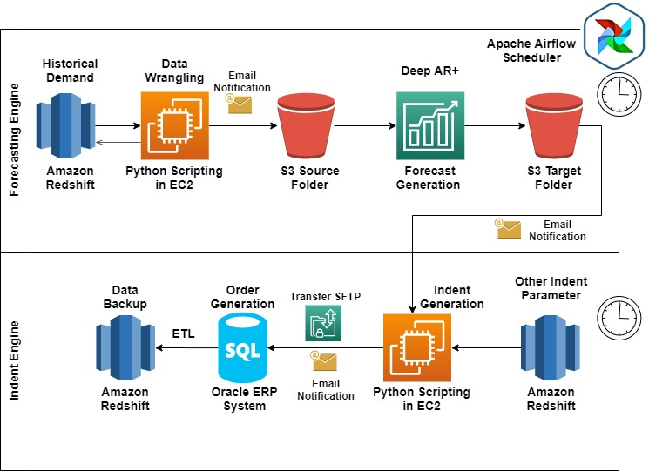
MORE RETAIL Integration with their existing order management system
Notes:
To automate their replenishment process, More Retail integrated Forecast into their existing Oracle order managements system

Slide 12

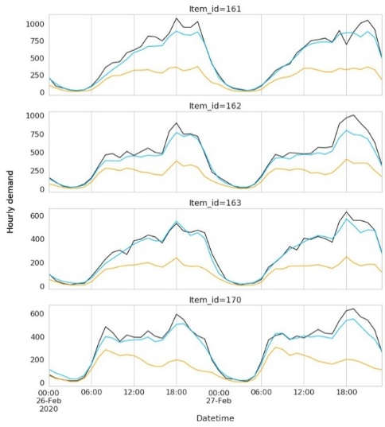


FEATURED INNOVATION: AMAZON FORECAST WEATHER INDEX Add weather with a single click to improve forecasts
Increase forecast accuracy by including local weather information that impacts demand
Take action stock extra inventory or increase staffing ahead of major weather events.
Experiment quickly We acquire, clean, and transform weather information to make it useful and ready to apply to your model
Notes:
Weather conditions influence demand for goods and services. With better forecasts, business can better stock products, staff appropriately, and plan merchandizing decisions
Incorporating weather information for a single decision or single location is straightforward; however, acquiring, cleaning, and effectively using live weather information for demand forecasting at scale is challenging and requires ongoing maintenance.
With this launch, you can now include 14-day weather forecasts for US and Europe locations with one click to your demand forecast. Forecast will take care of the heavy lifting on the back end.
To add weather, simply include the location information of your stores and select to include weather in the console or API. Weather is currently available in North America and Europe and we will be expanding to additional regions soon.

Slide 13
Q&A

Slide 14
Thank you!

Slide 15







Amazon Forecast in retail
Reduce waste and markdowns
Reduce over-forecasting and excess inventory at each point in the supply chain
Improve in-stock rates and inventory turns
Improve availability despite varying demand. Capture additional revenue with less inventory on hand
Staff to meet demand
Optimize staffing and hiring decisions in physical stores, distribution locations, and support centers
30%
Top grocery chain in India, reduced food waste by 30% while improving in-stock availability
Plan for new products
Accurately predict “cold-start” demand for new product introductions
Sense demand with external factors
Augment historical data additional data that will influence demand as weather, events, or related trends
Meet demand from pricing & promotions
Incorporate past pricing and promotion events to estimate demand from future events
Notes:
So, how can Amazon Forecast be used in retail?
Forecast for retail:
Reduce waste and markdowns
Reduce over-forecasting and excess inventory at each point in the supply chain
Improve in-stock rates and inventory turns
Improve availability despite varying demand. Capture additional revenue with less inventory on hand
Staff to meet demand
Optimize staffing and hiring decisions in physical stores, distribution locations, and support centers
Plan for new products
Accurately predict “cold-start” demand for new product introductions
Sense demand with external factors
Augment historical data additional data that will influence demand as weather, events, or related trends
Meet demand from pricing & promotions
Incorporate past pricing and promotion events to estimate demand from future events
AWS customer, More Retail, one of the largest hypermarket and supermarket chains in India is using Forecast to reduce food waste. Through more accurate ML forecasting, waste from fresh produce by 30% and improved in-stock rates from 80% to 90%

Slide 16
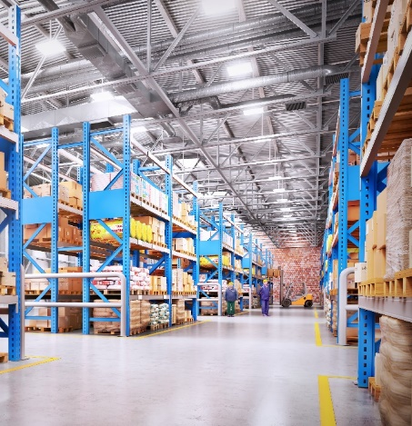




Amazon Forecast in manufacturing and distribution
Reduce rush fulfillments
Position inventory throughout your distribution network in anticipation of demand
Minimize inventory carrying costs
Meet demand with lower safety stock at all points in the supply chain and free up working capital
Secure favorable contract pricing
Accurately estimate future input material needs and reduce penalties
8%+
Global electronics manufacturer, Increased demand forecast accuracy 8%, improving resource utilization
Optimize staffing, training, and hiring
Plan for the right number of staff with the right skillsets
Incorporate industry-specific trends
Incorporate industry-specific data sets to augment your internal data
Improve capital utilization
Optimize production or logistics schedules to improve asset utilization
Notes:
Amazon Forecast is also frequently used in manufacturing and distribution.
Forecast for manufacturing and distribution
Minimize inventory carrying costs
Meet demand with lower safety stock at all points in the supply chain and free up working capital
Reduce rush fulfillments
Position inventory throughout your distribution network in anticipation of demand
Secure favorable contract pricing
Accurately estimate future input material needs and reduce penalties
Optimize staffing, training, and hiring
Plan for the right number of staff with the right skillsets
Incorporate industry-specific trends
Incorporate industry-specific data sets to augment your internal data
Improve capital utilization
Optimize production or logistics schedules to improve asset utilization

Slide 17




Easily bring highly accurate forecasting to any industry and function
Common applications in:
Retail
Manufacturing
Logistics
Food service
Hospitality
Energy
Telecom
Technology
Call centers
Financial
Media and advertising
…
Optimize forecasting for business impact
Use probabilistic forecasts to balance the different costs of under vs over forecasting (e.g., inventory carrying costs vs revenue opportunities)
Apply ML to learn across data sets
Improve forecast accuracy by learning from relationships between items and causal data in addition to historical patterns
Incorporate related data sets
Augment your historical data with relevant internal and external information that will impact demand such as weather, local events, and macro-economic trends
Integrate ML-forecasting into existing ERP, SCM, and OMS systems
Super-charge your workflow by integrating Amazon Forecast’s APIs directly into your existing tools
Notes:
Ultimately, forecasting is applicable across a wide range of industries and functions. Some cross cutting ways we see customers apply Forecast are:
Not only creating accurate forecasts, but also optimizing them for business impact
Over and under-forecasting often has different implications such as excess waste or lost revenue. Using probabilistic forecasting, customers can account for these differences and optimize forecast for their business
Applying ML to learn from other items in addition to historical data
Forecast is able to not only identify seasonal patterns and trends, but also subtle relationships between items that can drastically improve accuracy
Incorporate demand drivers
By adding in information that impacts demand such as price, weather, local events Forecast can augment historical data that drives demand.
Integrate ML-forecasting into existing ERP, SCM, and OMS systems
Forecasting is a critical step to larger optimization problems. Customers use Forecast’s APIs to supercharge their existing tools and processes with more accurate forecasts.

Slide 18










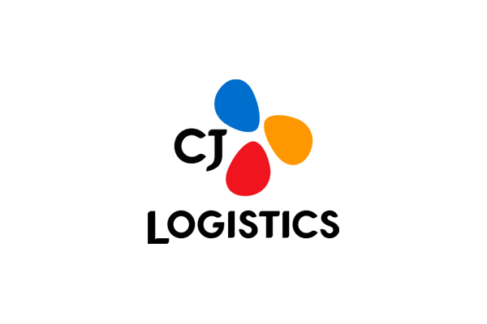



Amazon Forecast customers
ML FORECASTING SUCCESS BEING REALIZED ACROSS INDUSTRIES
Notes:
Many organizations across industries are seeing meaningful business impact using Amazon Forecast. For example:
More Retail, one of the largest supermarket and hypermarket chains in India, is using Forecast to reduce food waste and improve in-stock rates by predicting daily demand for 10’s of thousands of SKUs across ~700 stores.
Anaplan, a leading business planning SaaS company, is building Forecast into their PlanIQ platform to be the ML-engine under the hood
Foxconn, the largest electronics manufacturing companies in the world is using Forecast to better utilize specialized resources and skilled employees.

Slide 19













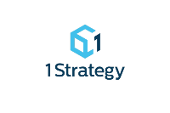





Amazon Forecast Partners
QUALIFIED PARTNERS WHO CAN HELP YOU IMPLEMENT FORECAST
Notes:
Additionally, we have a global network of qualified Amazon Partners who can help you apply Forecast to your business needs.

Slide 20
How we can help
GETTING STARTED
POC IN A BOX
Try out Forecast using our Getting Started Documentation to get a feel for the experience
Brainstorm use cases and get support for solution implementation
Brainstorm use cases and test the service with your own data and understand how it works in the context of your business
Hand-on or off support from the AWS team
AWS PARTNER NETWORK
IMMERSION DAY, WORKSHOPS, TRAINING, AND CERTIFICATION
Let AWS certified partners help you with the POC and build integrations with your current systems to productionize
Conduct training workshops and hackathons for builders in your organization
Practical education on ML for new and experienced practitioners
Based on the same material used to train Amazon developers
Notes:
We recommend that you start a POC to test out Amazon Forecast. AWS experts, Solution Architects and Partners can help you with a POC.

Slide 21

Reduced food waste and improved in-stock rates with accurate demand forecasting
More Retail uses Amazon Forecast to improve daily demand forecasting across its 22 hypermarkets and 625+ supermarkets. With Amazon Forecast, they reduced fresh produce waste by 30% and improved in-stock from 80% to 90%
Notes:
More Retail:
Aims to be India’s preferred choice for food and grocery needs with 22 hyper markets and 624 super markets across India
Network of 13 distribution centers, 7 fruits and vegetables collection centers and 6 staples processing centers
Business challenge:
High levels of shrink from fresh produce expiring before sale
Incorrect inventory placement leading to stock-outs at prime locations
Inconsistent order management processes relying on manager intuition
Approach
Focused on improving accuracy for SKUs driving business outcomes
Created a global model trained across thousands of store-item combinations
Optimized shrink vs stock-out risk for their business objectives
Integrated Forecast results with their Oracle Demantra order management system
Results:
Increased forecasting accuracy from 27% to 76%
Reducing fresh produce waste by 30%
Improved in-stock from 80% to 90%

Slide 22

Optimized factory resource allocation through improved demand forecasting
Foxconn uses Amazon Forecast to increase their product demand forecasts by 8% enabling them to better plan and allocate specialized resources and skilled employees. With Amazon Forecast, they have reduced manufacturing costs, increased capital utilization, and improved staffing and hiring.

Slide 23
Integrating ML-forecasting into demand planning platforms
Anaplan has integrated Forecast into PlanIQ, their intelligent planning platform to bring predictive insights to business decision makers across finance, supply chain, sales, and HR. With Forecast, they can offer customers more accurate, nimble, and reliable forecasts.

Slide 24
AMAZON FORECAST PRICING
Pay as you go model
Cost Type | Pricing
Generated forecasts | $0.60 per 1,000 forecasts (rounded to nearest 1,000)
Data storage | $.088 per GB
Training hours | $0.24 per hour
2 months of free usage limited to 10K forecasts, 10 hours training, 10GB storage
Pricing is based on time-series generated and not data points (e.g., 5 items in 5 stores = 25 unique forecasts)
Notes:
The pricing for Amazon Forecast is simple. It is a pay as you go model.

Slide 25
Additional cases

Slide 26

Marketing planning case study: Heroleads
Heroleads – lead generation marketing agency in South East Asia, Middle East and Africa
“…By integrating Amazon Forecast, we will free up the team to focus on more value-added work, expand the reach of our models to be used by other teams and improve our forecast model accuracy to 99%.”
Amit Das, Lead Data Engineer – Heroleads
Affordabletours.com
Specializes in lead generation, SEM, SEO, performance marketing and social media
Notes:
Heroleads is Southeast Asia's leading performance marketing company who provides clients with an integrated end-to-end solution that is tailored to their marketing needs and maximizes MROI.
Herolead’s media planner team spends over 60% of their time on building and maintaining manual forecast models, supporting the Sales & Operation Team to understand the performance trends of various digital marketing channels and industries and to plan how we achieve KPIs.

Slide 27

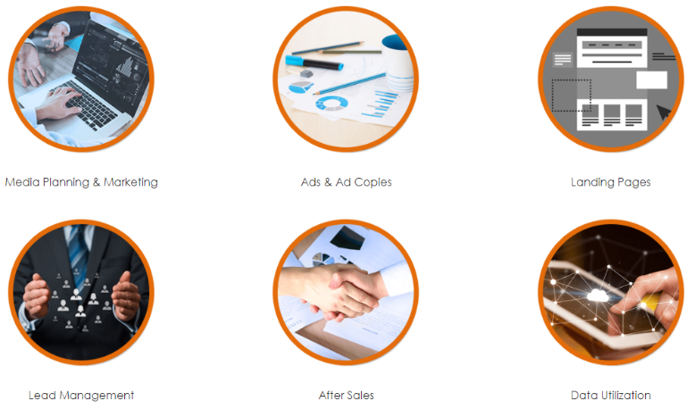
Marketing planning case study: Heroleads
Heroleads – lead generation marketing agency in South East Asia, Middle East and Africa
Business challenge:
Free up media planning team that spends over 60% of their time on building and maintaining manual forecast models to focus on more value-added work
Notes:
Full quote –
“Our media planner team spends over 60% of their time on building and maintaining manual forecast models, supporting the Sales & Operation Team to understand the performance trends of various digital marketing channels and industries and to plan how we achieve KPIs. By integrating Amazon Forecast, we will free up the team to focus on more value-added work, expand the reach of our models to be used by other teams and improve our forecast model accuracy to 99%. Using Forecast increases our ability to better serve our customers and increases the confidence within our team through faster insights, improved predictability, performance alerting systems, dynamic budget planning and more accurate investment models to ensure all our marketing campaign KPIs are met efficiently and at the right time." Amit Das, Lead Data Engineer - Heroleads

Slide 28



Marketing planning case study: Heroleads
Heroleads – lead generation marketing agency in South East Asia, Middle East and Africa
Historical data
Private
forecasting API
Clicks, Impressions and spend for past 1000
Campaign ids
Amazon Forecast
clicks
Impressions
Spend
Notes:
AffordableTour used their past call volume data for each of their 1-800 numbers. They are currently using Amazon Forecast to predict call volume for 5 days out in 15 min interval.

Slide 29

Capacity planning case study: Puget Sound Energy
Puget Sounds Energy – Energy service provider in Western Washington
“At PSE, we’ve used Amazon Forecast to forecast electric and gas consumption at a typical residence. We found that even with a very limited set of historical consumption and weather data, Amazon Forecast performed very well at forecasting 30 days out with virtually no manual effort.”
Paul Johnson, Sr. Cloud Architect
Puget Sound Energy
1.1 million electric customers
840,000 natural gas customers
4 million service area population
10 Counties served
Notes:
Puget Sound Energy (PSE) is Washington state’s largest utility, supporting 1.1 million electric customers and 825,000 natural gas customers in communities in 10 Washington counties.

Slide 30

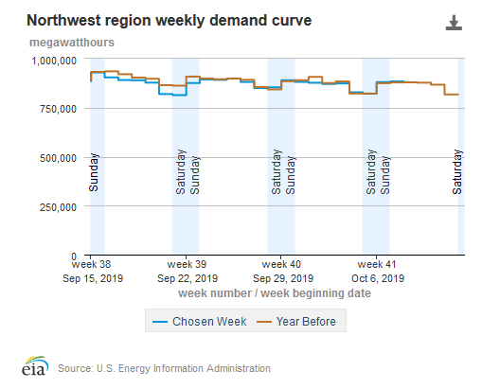
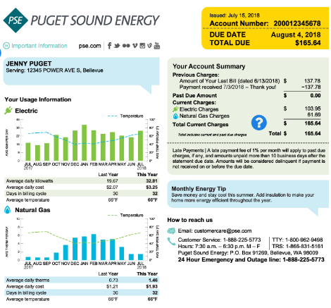
Capacity planning case study: Puget Sound Energy
Puget Sounds Energy – Energy service provider in Western Washington
Business challenge:
Predict energy demand for better resource allocation and outage management
Alert customers with a high bill warning
We could have saved a total of $25K for the month of July for these SKUs
Notes:
It’s important for Puget Sound Energy to forecast electric and gas consumption for all the 10 counties so that they can manage their resources better. As you’ll see in the graph on the left, energy needs change from year to year. In addition, they want to forecast energy usage at a typical residence and notify them upfront of their expected bill.

Slide 31
Capacity planning case study: Puget Sound Energy
Puget Sounds Energy – Energy service provider of Western Washington
Historical data
Private
forecasting API
Energy usage per customer
Related data
Weather
Amazon Forecast
Notes:
Puget Sound Energy used the historical data on energy usage per customer as their input. Since, energy usage is highly dependent on weather, they added a related time series on weather as an additional input to Amazon Forecast.
Forecast took this data and trained a model and created forecasts.

Slide 32
Inventory planning case study: CasaOne
CasaOne: Furniture rental e-commerce company operating in 6+ cities
“With Amazon Forecast, our sales prediction accuracy has improved by 20% compared to our existing forecasting algorithm. This means we can stock the right products and save on purchase costs..."
Madhusudan Kagwad, Co-founder and Head of Products
CasaOne
Monthly furniture subscription
Operating in 6+ cities
Leasing term from 1 to 12 months
Notes:
CasaOne offers a one-stop, cost-effective furniture rental/leasing solution with design guidance, seamless project management and a white-glove moving, delivery, and installation experience. They make sure customers get access to their furniture in a few business days. CaseOne operates in more than 6 cities and has a massive catalog covering different product categories.

Slide 33



Inventory planning case study: CasaOne
CasaOne - Furniture rental e-commerce company
Business challenge:
Predict product demand for fast and slow moving products across cities
Reduce inventory build up in warehouse
Frequent demand
Occupies less warehouse space
Infrequent demand
Occupies more warehouse space
We could have saved a total of $25K for the month of July for these SKUs
Notes:
CasaOne wants to better predict how many couches CasaOne customers might rent in the Bay Area or how many coffee tables customers might rent in NY. They have products of different sizes and weights, some are slow moving and some are fast moving. They also want to predict product demand and mix when launching in a new city.

Slide 34
Inventory planning case Study: CasaOne
CasaOne - Furniture rental e-commerce company
Historical data
Private
forecasting API
Past sales of Beds, Mattresses and Sofas
per city
Amazon Forecast
Notes:
CasaOne used their past data on sales of different types of Beds, Mattresses and Sofas. They fed this historical data to Amazon Forecast, which trained the model automatically and created Forecasts.

Slide 35

Inventory planning case study: OMOTOR
OMOTOR – Machine learning SaaS provider
“…we can use more contextual data, optimize more frequently, generate forecasts with upwards of 50% improvements in accuracy... Amazon Forecast gives us the ability to create and refine various forecasts from time series data without having to build and train a model manually… ”
Marcio Rodrigues, CEO
OMOTOR
SaaS provider in Brazil
Integrates AI solutions
Provides services leading technologies
Notes:
OMOTOR helps businesses improve through AI by providing them with the best of machine learning algorithms, computer vision techniques and cognitive bots that can communicate via WhatsApp and others platforms.

Slide 36


Inventory planning case study: OMOTOR
OMOTOR – Machine learning SaaS provider
Business challenge:
Assist an automotive customer predict sales across 185 vehicles in Brazil
We could have saved a total of $25K for the month of July for these SKUs
Notes:
They were helping an auto manufacture predict sales of 185 vehicles across Brazil.

Slide 37
Inventory planning case study: OMOTOR
OMOTOR – Machine learning SaaS provider
Historical data
Private
forecasting API
Pasts sales of 185 vehicles for various make and models
Related data
Price
Amazon Forecast
Notes:
They took their historical data of all the vehicles and added additional data to give Amazon Forecast more context. They added the price of vehicles as well. Amazon Forecast trained the model and create forecasts.

Slide 38

Workforce planning case study: AffordableTours
AffordableTours – travel sellers of escorted tours, cruises, river cruises, and active vacations in the US
“…By using Amazon Forecast we are now able to anticipate customer demand call volumes to ensure we have the right number of agents each day improving our missed call rate by approximately 20%.”
Marc Rosenthal, Senior Project Manager
Affordabletours.com
Award winning service team
Tours across 6 continents
A+ rating with the BBB since 2001
Notes:
AffordableTours.com is a travel sellers of escorted tours, cruises, river cruises, and active vacations in the US. Their customers have a compelling incentive to pick up the phone and call them. They diligently work to offer their customers low prices on travel packages helping them see and experience new wonders. For their business to thrive and to offer even lower prices, they need to find efficiencies everywhere possible. With their global presence they regularly ran into issues having unbalanced resourcing to handle customer call volumes. Some days they had too many agents and other days they had too few which would create inconsistent customer experiences increased our missed call rates and operating costs. By using Amazon Forecast they are now able to anticipate customer demand call volumes to ensure they have the right number of agents each day improving their missed call rate by approximately 20%.

Slide 39

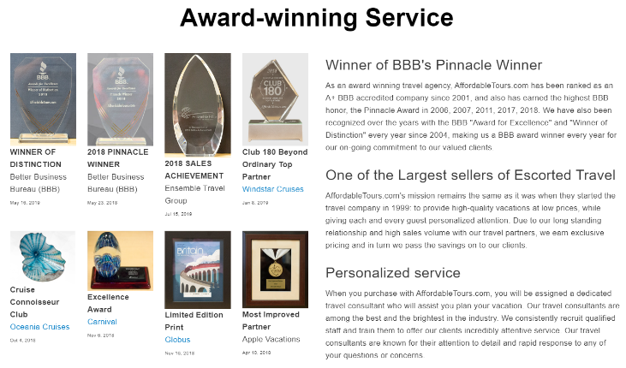

Workforce planning case study: AffordableTours
AffordableTours – travel sellers of escorted tours, cruises, river cruises, and active vacations in the US
Business challenge:
Optimize resources to handle customer call volumes
Ensure consistent customer experiences
Reduce operating costs
Notes:
For AffordableTours their customer service is the most important to them. They want to give the same experience to customers in low call volume or high call volume scenarios. To keep up their service, they looked to Amazon Forecast to accurately forecast call volumes.

Slide 40
Workforce planning case study: AffordableTours
AffordableTours – travel sellers of escorted tours, cruises, river cruises, and active vacations in the US
Historical data
Private
forecasting API
Past call volume for each
1-800-number
Amazon Forecast
Forecasting call volume for 5 days out in 15 min intervals.
Notes:
AffordableTour used their past call volume data for each of their 1-800 numbers. They are currently using Amazon Forecast to predict call volume for 5 days out in 15 min interval.

Slide 41
Capacity planning case study: CJ Logistics
CJ Logistics – Logistics service providers forecasting labor needs
“Amazon Forecast allows us to use sophisticated machine learning-based forecasting techniques without building our own system. We have a clear method for increasing our operational efficiency by using Amazon Forecast.”
YoungSoo Kim, Vice President of TES Strategy Unit
CJ Logistics
Operates in 290 locations in Asia
Handles 6.6M parcels/day
48.2% market share
Korea’s No. 1 parcel service provider
Notes:
CJ Logistics is a leading integrated transportation and logistics service provider for individuals and companies in Korea. It is a one-stop logistic solution. It plays a major role in global logistics innovation.

Slide 42








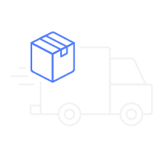



BASED ON THE TECHNOLOGY THAT POWERS AMAZON.COM
Forecasting is critical to deliver on customer promises
Product availability
Lower price
Fast delivery
Notes:
Amazon has accumulated a wealth of forecasting experience from over 20 years of experience operating their ecommerce business.
Amazon is a global company that ships billions of packages a year, and operates in more than 185 countries across the globe. We have to determine exactly how to manage buying, placement, transfers, and removals, across the vast network in an automated fashion. We have to stay within our fulfillment center capacity, and fulfill customer promises on time. A supply chain of this size comes with its own set of complexities and problems. We manage these complexities through science and technology at scale.
We have promised our customers that they will find the product that they are looking and that we’ll deliver the product to them as at faster speeds than ever before. We have made a decision to continuously and significantly lower prices for customers year after year as our efficiency and scale make it possible. Our judgment is that relentlessly returning efficiency improvements and scale economies to customers in the form of lower prices.

Slide 43

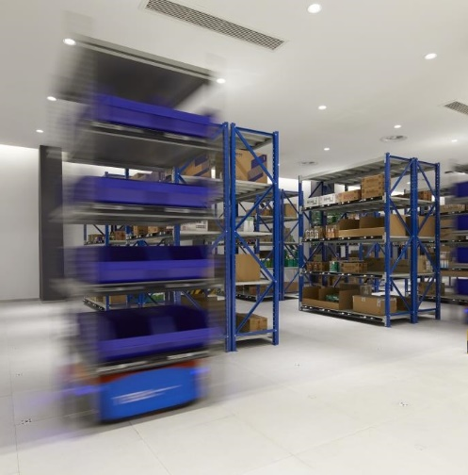
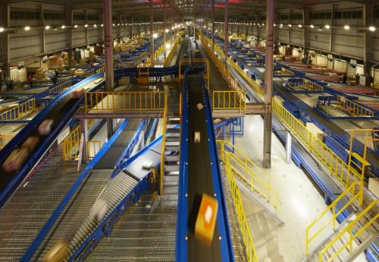
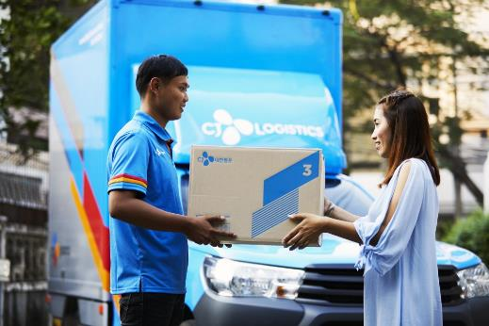
Capacity planning case study: CJ Logistics
CJ Logistics – Logistics service providers forecasting labor needs
Business challenge:
Optimize amount of human resources, transportation, and warehouse space to provision
Forecasting shipment volume across 303 terminals
Notes:
CJ Logistic wanted to forecast shipment volumes of each of CJ Logistics 303 terminals. Each location/terminal serves several clients and handles parcel shipments of several clients per terminal. To optimize their resources, they want to forecast shipment volumes at each terminal.

Slide 44
Capacity planning case study: CJ Logistics
CJ Logistics – Logistics service providers forecasting labor needs
Private
forecasting API
Historical time-series
Shipment volume at 303 terminals for 212 days
Amazon Forecast
Built-in dataset
Holiday and weekend data
Notes:
CJ Logistics fed 212 days of data for each of the 303 terminals. The provided a total of 64236 (303 terminals *212 days) data points. And they added the Holiday time series as shipment volume and manpower differs on such days. For high volume terminals, the time series appear to have a weekly pattern where the volumes are high on Mondays and then drop towards the weekend. So they selected the Holiday time series in built into Amazon Forecast for you to select.
Amazon Forecast trained the model and created accurate forecasts. In this situation, Amazon Forecast was able to predict highly spiky data as well.

Slide 45


More customer cases studies
DevFactory and Planalytics – software and analytics providers
DevFactory is the factory for repetitive, low-value tasks in software development that allow dev teams to focus their precious development resources on delivering value to their products and clients.
“…We’re using Amazon Forecast as a foundational capability in some of our products to more accurately predict sales and be able to deliver better inventory planning as a result… This not only makes our products simple to build and maintain, but it also offers our customers greater accuracy, availability, and scalability. This is a real win not only for us but also for our customers.”
Rahul Subramaniam, CEO - DevFactory
Planalytics, Inc. is the global leader in Business Weather Intelligence®, delivering comprehensive weather analytics to help organizations make stronger business decisions.
“…Using Amazon Forecast, we are able to quickly and effectively quantify the forecast improvement we bring to our most advanced clients over the use of raw weather data. The quantification has been a game-changer for Planalytics, enabling us to prove real ROI to our customers."
Derron Simon, Chief Operating Officer - Planalytics
Notes:
Here are some more customers that have seen benefits from Amazon Forecast.

